Slide 1
Geo-localization of Low-altitude Overhead Image Using Multi-layer Shape Matching
Yuhang Li

Slide 2
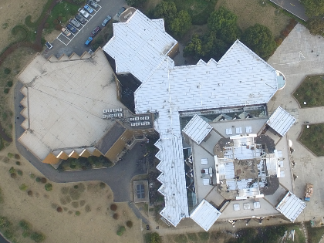
Background
Geo-localization
Image-based navigation
Augmented reality (AR)
3D reconstruction

Slide 3
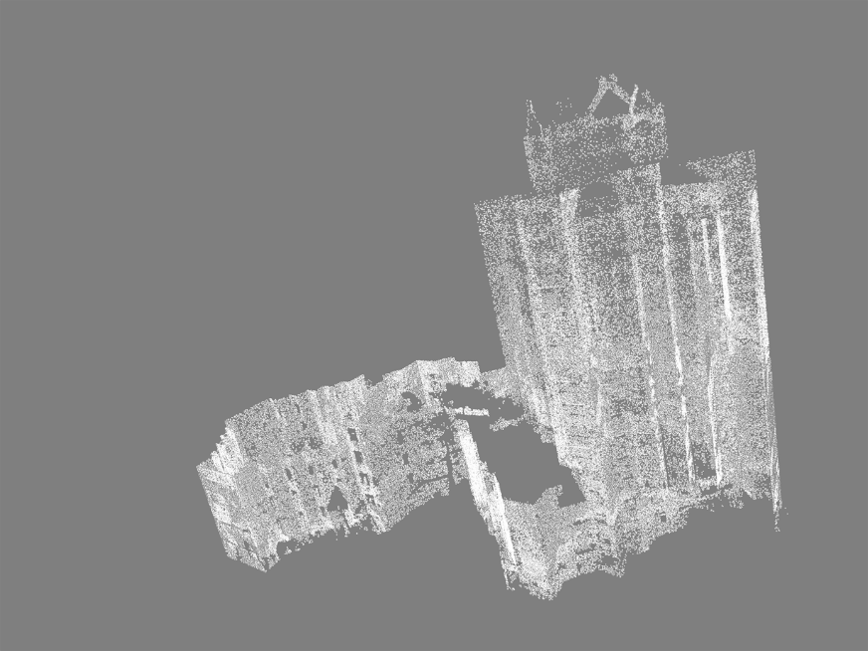
Task
Register a point cloud onto a video
Video: a flying platform
Point cloud: a laser scanner
Notes:
A frame of the video

Slide 4
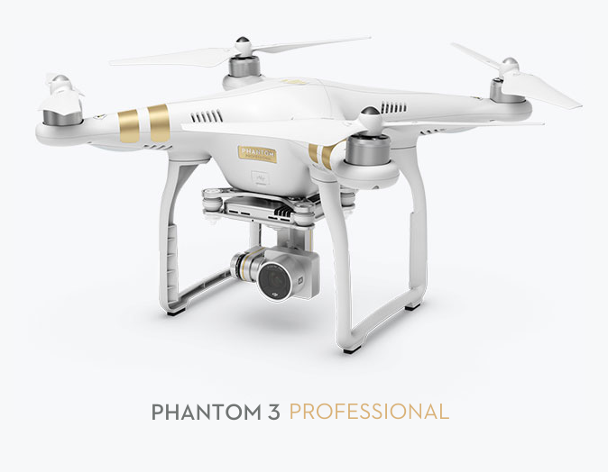
Task
Register a point cloud onto a video
Video: a flying platform
Point cloud: a laser scanner
Notes:
A flying platform; a laser scanner

Slide 5
Projection Matrix
video
Target image
Edge image
Optimization
Point cloud
Global projection
Hough
transform
α
Feature point pairs
Local projection
Rotated projection
Fast Chamfer
matching
Feature point pairing

Slide 6
Projection Matrix
video
Target image
Edge image
Optimization
Point cloud
Global projection
Hough
transform
α
Feature point pairs
Local projection
Rotated projection
Fast Chamfer
matching
Feature point pairing

Slide 7
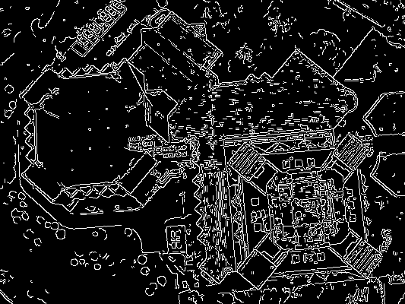

Slide 8
Projection Matrix
video
Target image
Edge image
Optimization
Point cloud
Global projection
Hough
transform
α
Feature point pairs
Local projection
Rotated projection
Fast Chamfer
matching
Feature point pairing

Slide 9
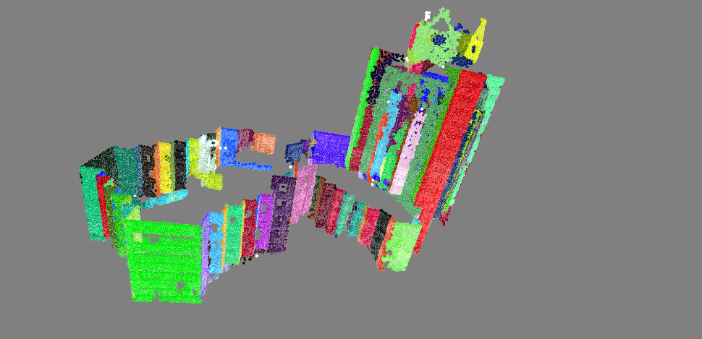
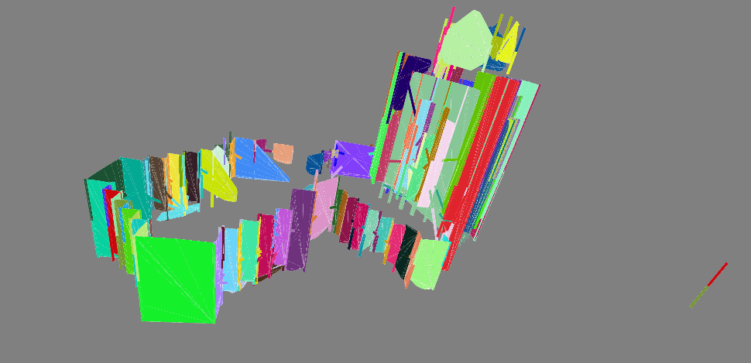
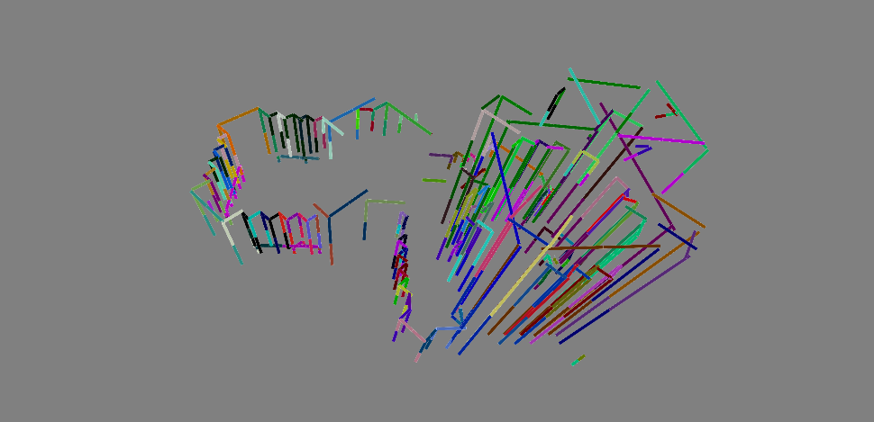
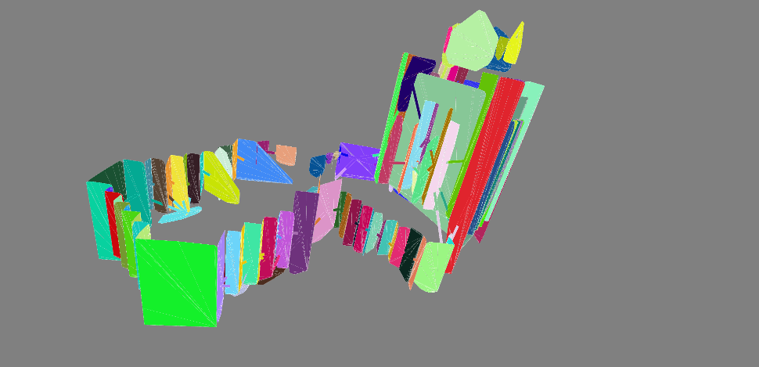
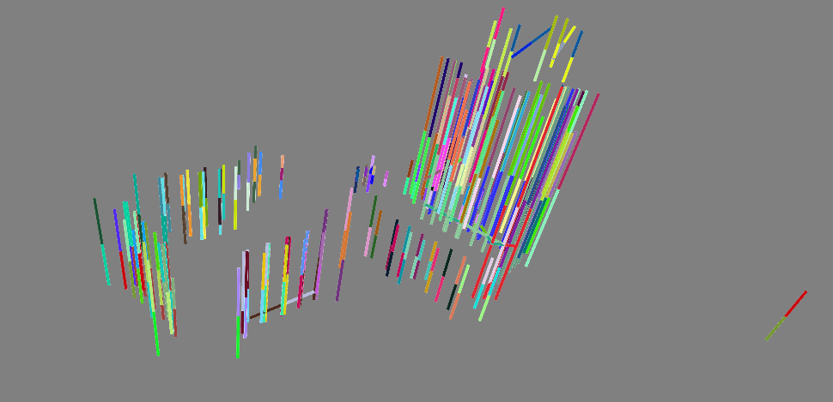
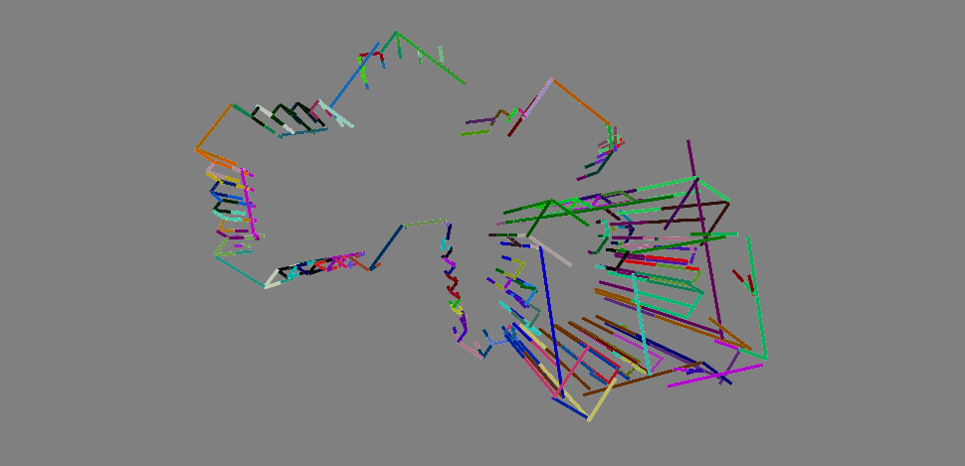
Point cloud
Notes:
Colors differs from one segment to another

Slide 10
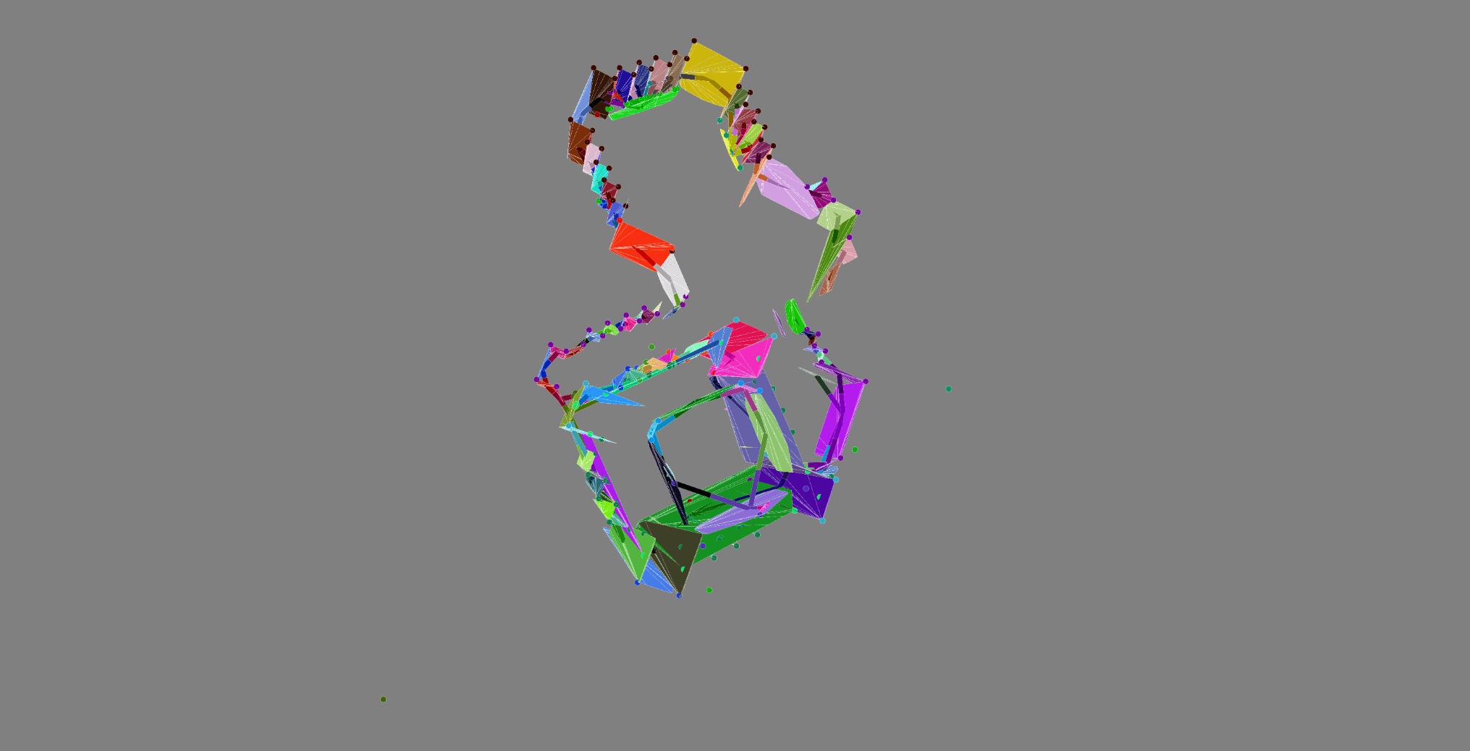
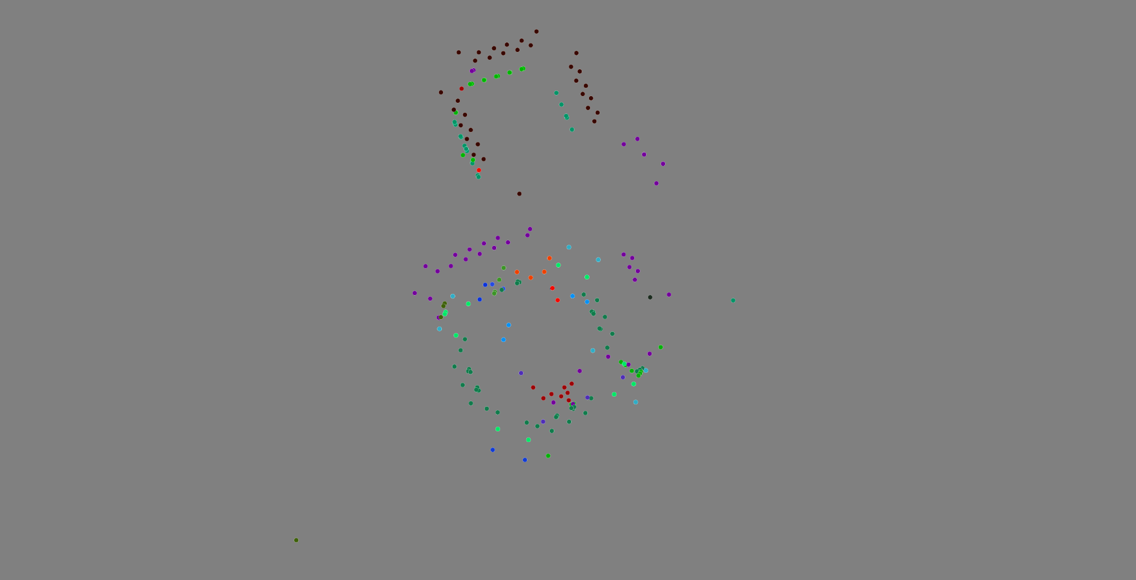
Feature points of point cloud
Notes:
They will be used later

Slide 11
Projection Matrix
video
Target image
Edge image
Optimization
Point cloud
Global projection
Hough
transform
α
Feature point pairs
Local projection
Rotated projection
Fast Chamfer
matching
Feature point pairing

Slide 12
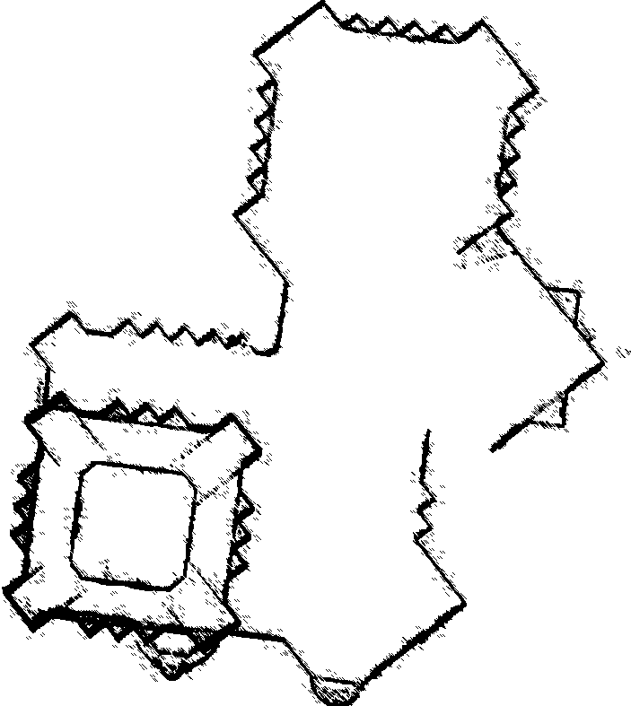
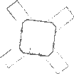
Point cloud projection image

Slide 13
Projection Matrix
video
Target image
Edge image
Optimization
Point cloud
Global projection
Hough
transform
α
Feature point pairs
Local projection
Rotated projection
Fast Chamfer
matching
Feature point pairing

Slide 14

Rotation: Hough transform
Notes:
Compute the rotation in Hough transform space

Slide 15
Projection Matrix
video
Target image
Edge image
Optimization
Point cloud
Global projection
Hough
transform
α
Feature point pairs
Local projection
Rotated projection
Fast Chamfer
matching
Feature point pairing

Slide 16
Projection Matrix
video
Target image
Edge image
Optimization
Point cloud
Global projection
Hough
transform
α
Feature point pairs
Local projection
Rotated projection
Fast Chamfer
matching
Feature point pairing

Slide 17
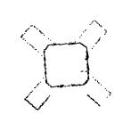
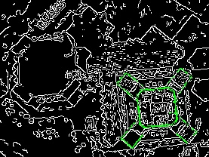
Fast Chamfer distance matching

Slide 18
Projection Matrix
video
Target image
Edge image
Optimization
Point cloud
Global projection
Hough
transform
α
Feature point pairs
Local projection
Rotated projection
Fast Chamfer
matching
Feature point pairing

Slide 19
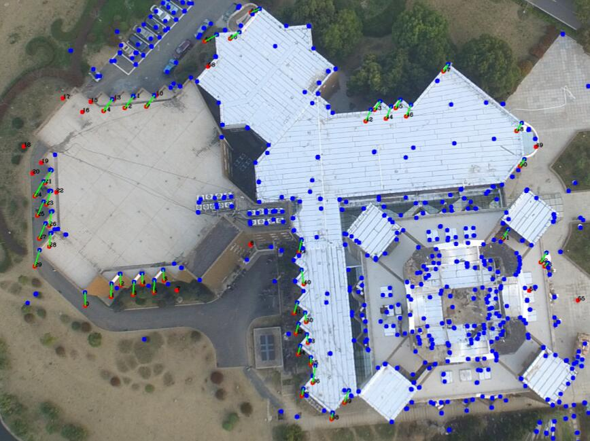
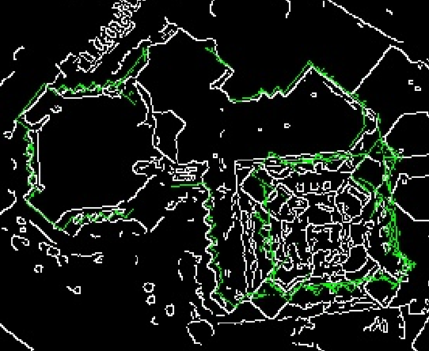
Feature point pairing
Notes:
Feature points of Point cloud are generated above
Feature points of image are computed Harris corner detection

Slide 20
Projection Matrix
video
Target image
Edge image
Optimization
Point cloud
Global projection
Hough
transform
α
Feature point pairs
Local projection
Rotated projection
Fast Chamfer
matching
Feature point pairing

Slide 21


Projection Matrix
video
Target image
Edge image
Optimization
Point cloud
Global projection
Hough
transform
α
Feature point pairs
Local projection
Rotated projection
Fast Chamfer
matching
Feature point pairing

Slide 22

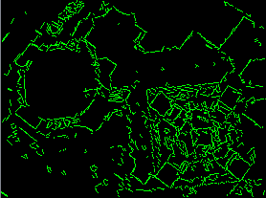
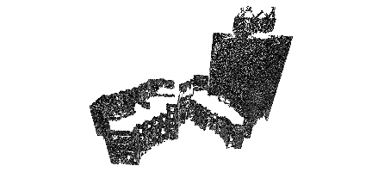
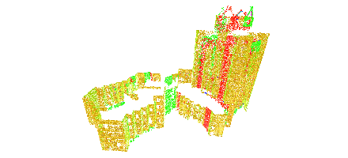
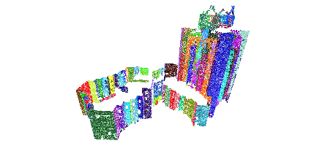
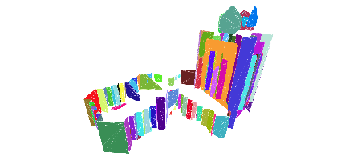
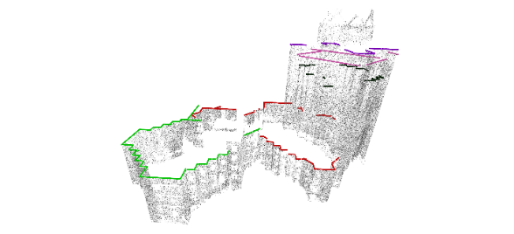
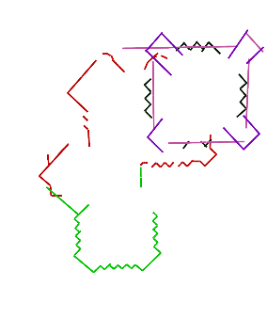
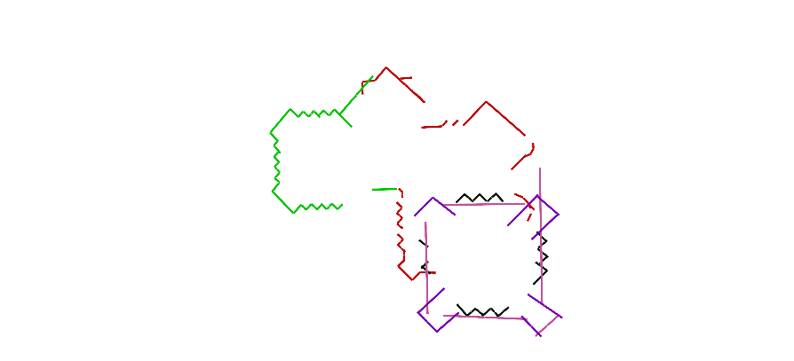
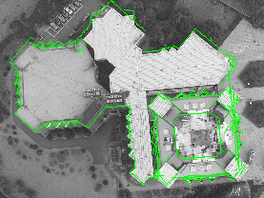
Geo-localization of Low-altitude Overhead Image Using Multi-layer Shape Matching
Background
Geo-localization is a key technique to image-based navigation, augmented reality (AR) and 3D reconstruction.
Problem statement
Input
Overhead images captured by a quadrotor in a low altitude.
Building point clouds scanned by a ground laser device.
Rough sensor (GPS, accelerator, compass…) parameters for initialization.
Output
6DoF (3D for orientation and 3D for translation) camera pose of input image with respect to global point cloud coordinate system.
Challenge
Outdoor environments: more complicated due to more occlusions, more classes of objects and less regular layouts.
Overhead: not able to take advantages of vanishing points.
Low-altitude: not able to employ identical scale assumption.
Input image
Edge image
2D line presentation
Image processing
Input point cloud
Normal estimation
Over-segmentation
Planar fitting
Multi-layer projection
Multi-layer 3D line presentation
Point cloud processing
Rotated 3D line presentation
Alignment result
Multi-layer geo-location

Slide 23
Thanks！

